Slide 1
Languages Final R

Slide 2
Memory safety
Not considered memory safe
Does have garbage collector
Handles memory allocation by itself
Doesn’t prevent all memory related issues

Slide 3

Programming style
Data manipulation tools often use functional
Primarily used in a procedural style

Slide 4

Unique Features
Run select lines
Designed for data science
Has built in plot display
Has built in variable explorer

Slide 5
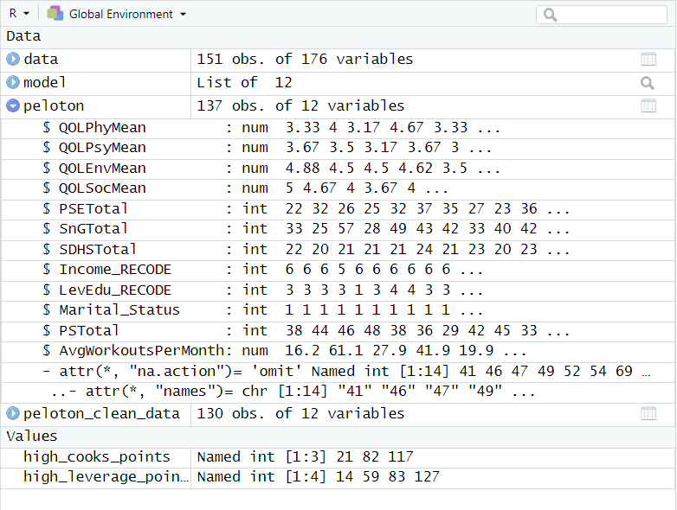
variable explorer

Slide 6
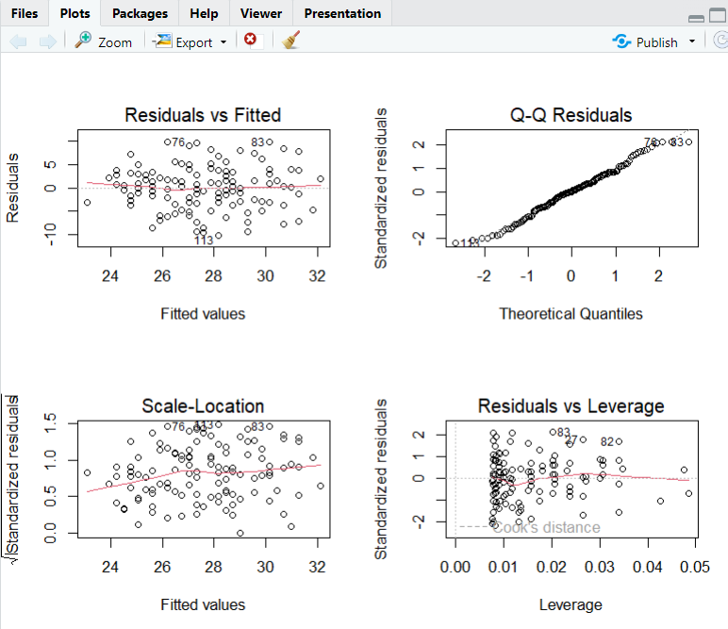
Plot Display

Slide 7
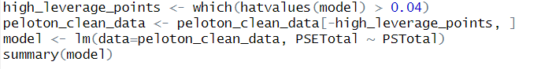
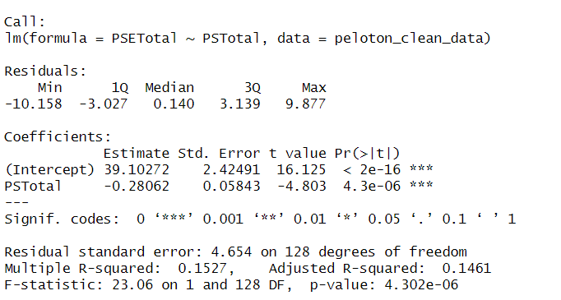
Syntax

Slide 8

Primary uses
Data Manipulation
Data Visualization
Modeling/Machine Learning
Data Science

Slide 9
THANK YOU

